Slide 1
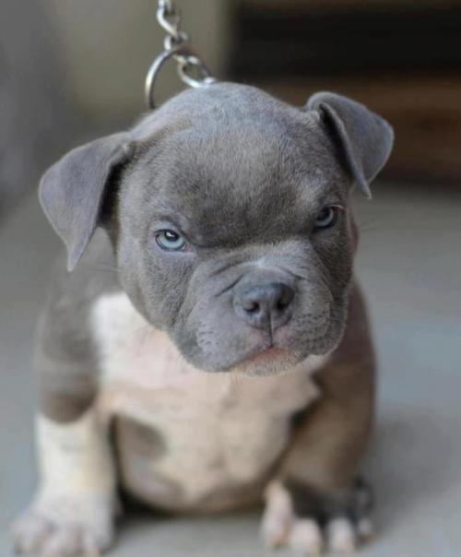
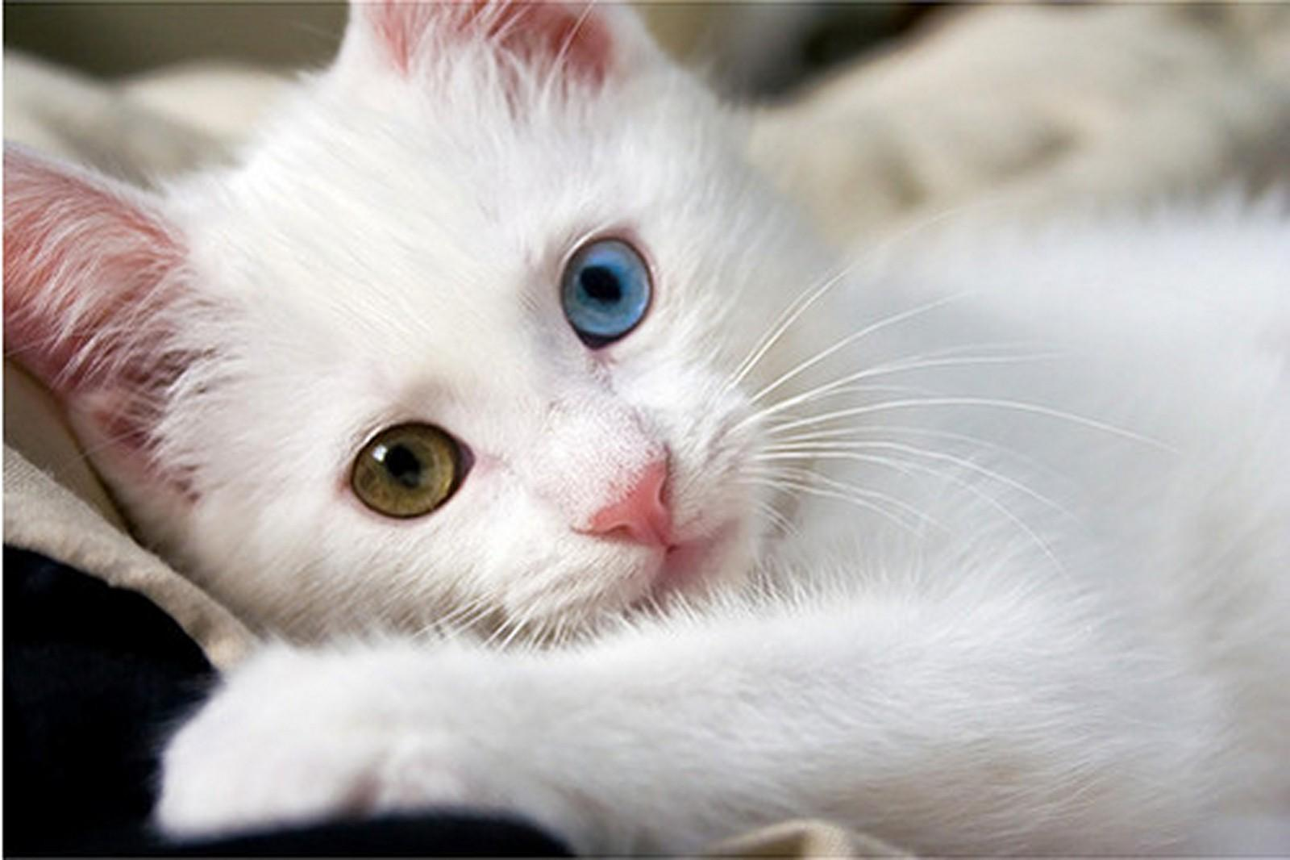
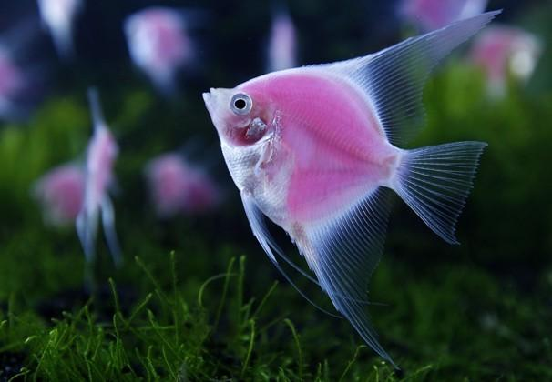
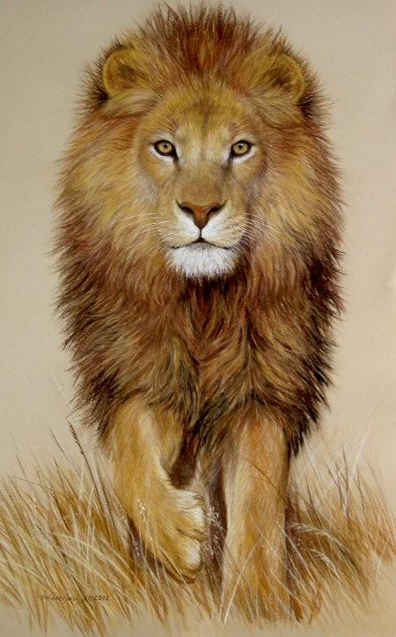
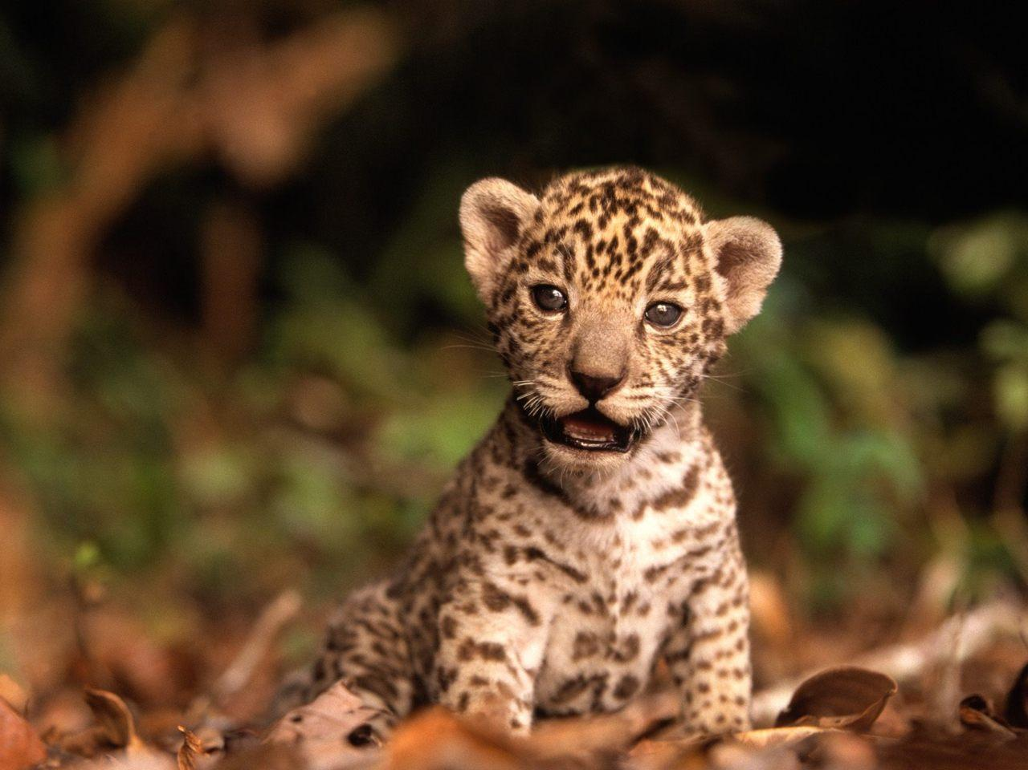
Animal Awareness
Help protect animals all around the world!

Slide 2
What is animal awareness?
Animal awareness is all about helping and caring about animals. Also about not letting animals go extinct or get endangered.

Slide 3
What does extinct mean?
Extinct means that an animal no longer exists in our world.

Slide 4
What does endangered mean?
Endangered means that an animal is in a high risk of going extinct.

Slide 5
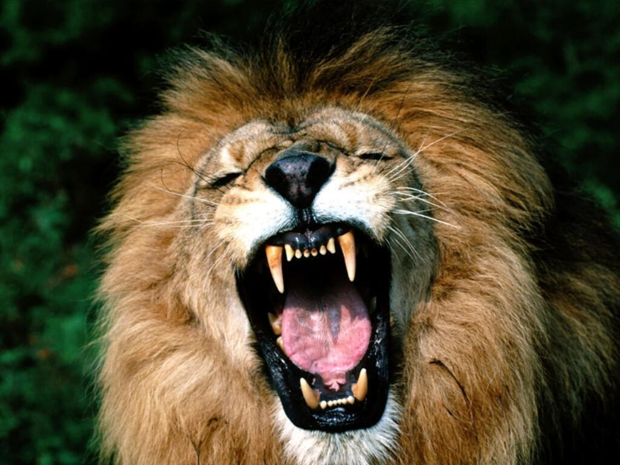
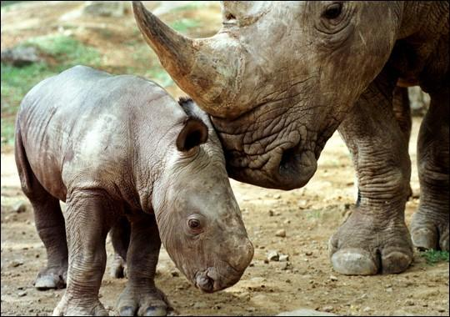
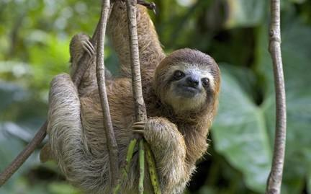
Extinct animals:
-African Lion
-Pygmy Three Toed Sloth
-Javan Rhino
-Dinosaurs
And just think that there is more than a million extinct animals.

Slide 6
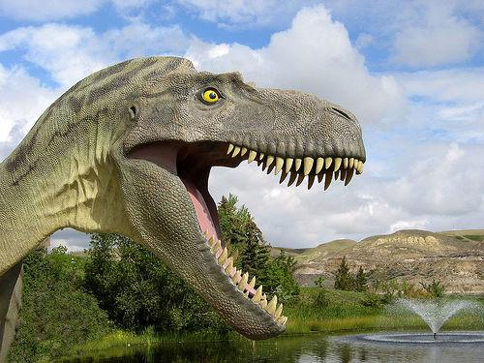
Dinosaurs!
ROAR! WHY AM I EXTINCT???

Slide 7
What is abusing animals?
Abusing an animal is when you don't take care of them or when you hurt them. Some way animals are getting abused are, being beaten, starved, or getting burned.

Slide 8
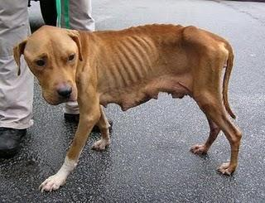
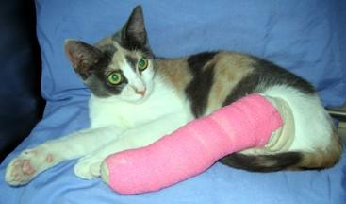
Abused dog & cat
Starved Beaten

Slide 9
What if that was your animal?
How would you feel if that was your cat or your dog? I know if that was my animal I would be devastated! You probably would too.

Slide 10
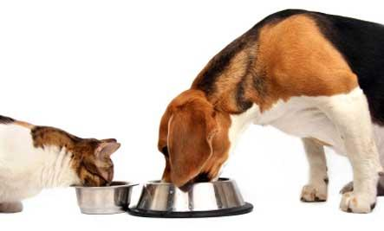
How to help your animals...
- Feed your animals plenty of food a day.
- Give your animals water daily.
- Make sure they live in a clean environment.
- If they do something wrong do not harm them.
- Play with them.

Slide 11
Please help!
So please take this video seriously. Try to take an interest into extinct or abused animals. Thank you! Any questions or comments?

Slide 12
Websites
If you're interested in helping these animals, here is the links:
http://www.kidsites.com/sites-edu/animals.htm
http://www.animalfactguide.com/links/
http://www.animalcorner.co.uk/
https://www.avma.org/KB/K12/Pages/petpourri-activity1.aspx

