Slide 1
Darwin’s Discovery
By: Sydney Kerl

Slide 2
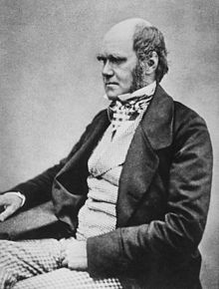
Who was Darwin?
Charles Robert Darwin was born February 18, 1809.
Darwin was an English naturalist who discovered that organisms have traits and those traits we call adaptations, make the organism more fit to survive and reproduce.
He called this natural selection.

Slide 3
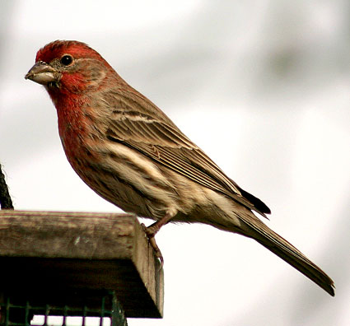
His Voyage
In 1831 at the age of 22 Robert joined the crew of the HMS Beagle as a naturalist.
He visited much of South America and had his big thought after visiting the Galapagos Islands where he studied Tortoises and Finches.

Slide 4
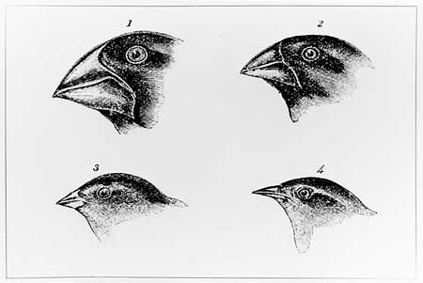
His Thought
After studying the Finches he noticed that their beaks were one of their main adaptations.
Each of their beaks were specialized for their environment.

Slide 5
BIG IDEAS: Observations
Animals overproduce offspring
Variation occurs in offspring
Variation is inherited from parents
Natural Selection is conducted through the struggle to survive (through competition)

Slide 6
The Journey Ended
When the journey came to an end in 1836, Darwin’s father organized investments so his son could be a self funded, gentleman scientist.
And that he did.

Slide 7
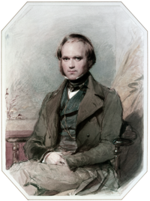
A New Beginning
Charles was still young and had a great career as a scientist ahead of him.
He traveled around London and gave presentations to the Zoological Society sharing his discovery.

Slide 8
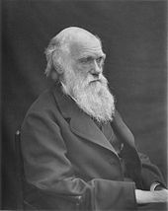
Death
Charles Robert Darwin lived his life to the fullest but, died to a heart disease on April 19, 1882 at the age of 73.

Slide 9
Quotes By: Darwin
“A man who dares to waste one hour of time has not the discovered the value of life”
“The highest possible stage in moral culture is when we recognize that we ought to control our thoughts.”
http://www.brainyquote.com/quotes/authors/c/charles_darwin.html

Slide 10
THE END

